Slide 1
Welcome to
Math & Logic!

Slide 2
Review: What did we do in class last time?
Review: What are some problem solving techniques we have used in Math & Logic this term and the situations where we have applied them?
Preview: Why did the Titanic sink?
Notes:
Review: Sets
Review: … remember the Numbrix puzzle … algebra … number systems … sets ...
Preview: The 5 Whys -- multiple points of view

Slide 3
Problem Solving
Competency: Utilize heuristic tools for problem solving
Problem Solving
Root Cause Analysis
Flowcharts

Slide 4
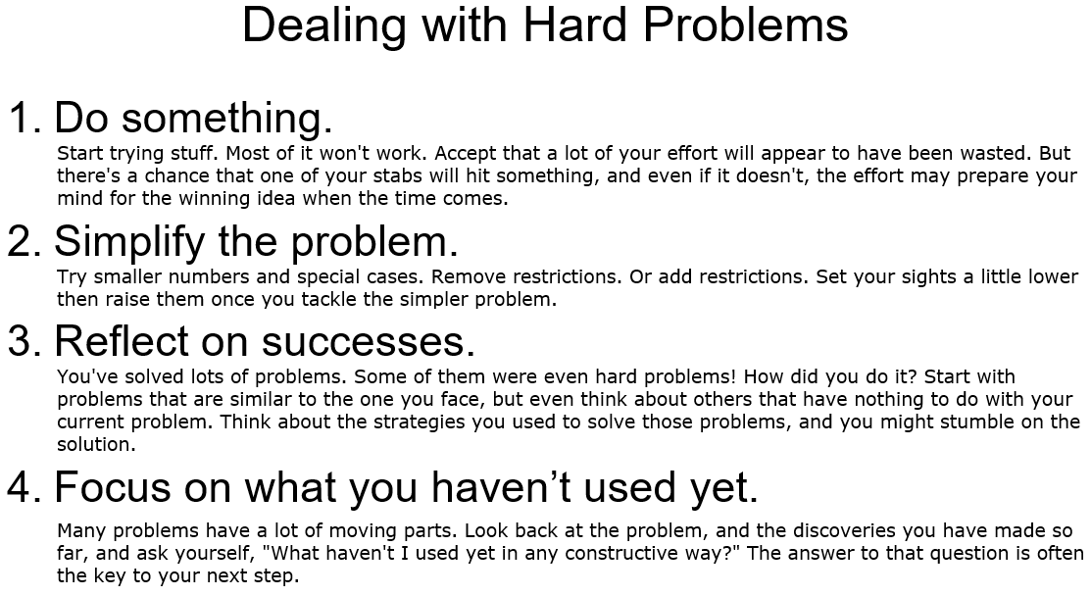
Notes:
Which of these strategies have we used this term? What other strategies have we used this term in Math & Logic?

Slide 5
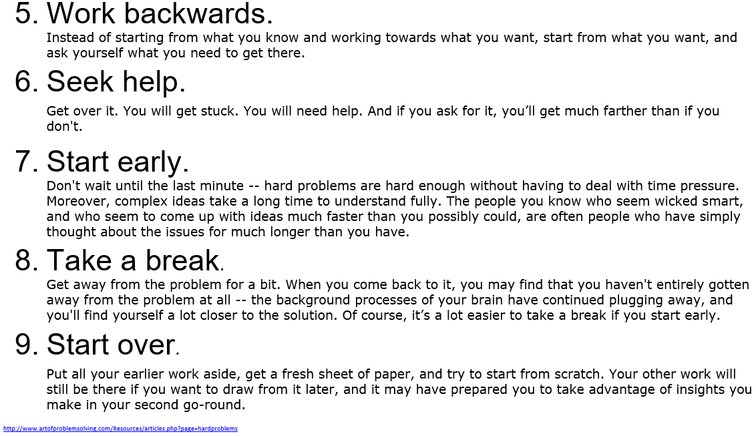
Notes:
http://www.artofproblemsolving.com/Resources/articles.php?page=hardproblems

Slide 6
Problem Solving Strategies
Look for a pattern
Make an organized list
Guess and check
Make a table/chart
Work backwards
http://fcit.usf.edu/math/resource/fcat/strat.htm
Use logical reasoning
Draw a diagram/graph
Solve a simpler problem
Use what worked before
Eliminate possibilities

Slide 7
Root Cause Analysis
We want to solve problems so they do not come back.
Instead of putting band-aids on symptoms, we solve problems at the root cause.

Slide 8
The 5 Whys
Five Whys Jefferson Memorial Example

Slide 9
Titanic Example
People may point to different causes.
Rivets were not strong enough. Lookouts saw iceberg too late. Ship was going too fast.
All are accurate.
Nevertheless, the Titanic sank.
https://www.youtube.com/watch?v=38RlXdr4Np0
Notes:
A drawback of 5 Whys -- people may point to different causes, and all can be accurate, multiple causes.

Slide 10
Flowchart Symbols
Notes:
One way to define the process is to make a flowchart.

Slide 11
Flowchart Symbols
Terminal
Process
Decision

Slide 12
Flowchart
Let’s practice now!
Notes:
Flowchart Practice

Slide 13
Review
Problem Solving
Root Cause Analysis
Flowcharts

Slide 14
To Do:
Problem Solving Assignment
Test on Sets and Heuristics
Crash Course 19
Crash Course 20

Slide 15
Have a great day!
And remember that every day
at CVTC is a great day!

